Slide 1
BUSINESS PLAN AND PROPOSAL

Slide 2
What can you do
for a customer?
How does your customer acquire your product?
Who is your customer?
A product or service around which you can build a profitable company and a net positive return to investors
Purpose
Problem
Solution
Why Now
Market Size
Competition
Product
Business Model
Team
Financials
How do make money off your product?
How do you design and build your product?
How do you scale
your business?

Slide 3
Company Purpose
#1
Define the company/business in a single
declarative sentence
Highlight what you are creating
Bring out the value and benefits emerging
out of the venture
Building A New Business
Opportunity
Vision
Access to Resources
Distinctive Competencies
Capabilities of the Team
Innovation or
Novelty
Business Strategy
Industry Context
Talent
Structure
Processes
Profitability

Slide 4
Problem
#2
Describe the need of the customers
Outline how the customer addresses the
issue today
List out specific areas which need to be
addressed

Slide 5

Solution
#3
Demonstrate your company’s value proposition
to make the customer’s life better
Show where your product physically sits
Provide use cases
 |  |  | Positioning Statement
What are you developing? For Whom? What Value are you bringing? Benefit in practical terms: In use In cost
 |  | For (target customer) who (statement of need or opportunity) that (statement of benefit) Differentiation Unlike (primary competitive alternative) our product (statement of primary differentiation
 | Problem- Solution Fit

Slide 6
Team
#4
Founders & Management : specialization, role and
commitment
Board of Directors/Board of Advisors
Please indicate who are helping you and why?
Indicate how the team will be expanded over the next
two years in terms of:
Development, production and marketing needs ; and
Expertise and experience needed

Slide 7
Why Now
#5
Set-up the historical evolution of your
product/service category
Define recent trends that make your solution
possible
The Elements of the Business Story
Background
Describe the current situation, the
characters, and the problem.
Challenge
Describe the challenges and conflicts that impede a coherent plan to solve the problem.
Resolution
Portray a solution to the challenges and the problem and how the venture will succeed by resolving the problem.
Set your development in the form of a real-life story

Slide 8
Market Size
#6
Identify/profile the customer you cater to
Calculate the
  TAM,
  SAM ,and
  TM
How big is the
universe?
TAM
How many
can I reach?
SAM
TM
Most likely
buyers?
Clearly mention the
  logic & basis
Reasonable estimate for
TAM
Total Available Market Combined revenues of all companies that can theortically serve a market
years 1 & 2 followed by 5 yrs
SAM
Served Available Market
The subset of the market that your sales team can address or that the product provides specific value
Market size potential: Rs 25 crore-Rs 100 crore
Venture growth rate:
Market share: Entry barrier:
20% to 40%
10% to 25%
Timing and size
TM
Target Market – Beach-head
The initial focused customer base that your product will reach

Slide 9
Competition
#7
List competitors
List competitive advantages
Bring out clearly advantages of your offering
in terms of:
  Functionality
  Features
  Range
  Price
What could be the most difficult hurdles?
How you will try to overcome them?

Slide 10
Product
#8
Product line-up (form factor, functionality,
features, intellectual property)
Roadmap: Definition & architecture
  Development & operations plan
Highlight specific values being offered to the
customer
Five values offered to a customer
Product: Performance, quality, features,
brand, selection, search, easy to use, safe
Price: Fair, visible, consistent, and reasonable
Access: Convenient, location, nearby, at-
hand, easy to find, in a reasonable time
Service: Ordering, delivery, return, check-out
Experience: Emotional, respect, ambiance,
fun, intimacy, relationships, community
Product-
Market Fit

Slide 11
Business Model
#9
Revenue model
Pricing
Unit economics
Average account size and/or lifetime value
Sales & distribution model
Customer/pipeline list
Key assets
Customer Value Proposition
Technology and Operations Management Go-To-Market Strategy
Profit Formula

Slide 12
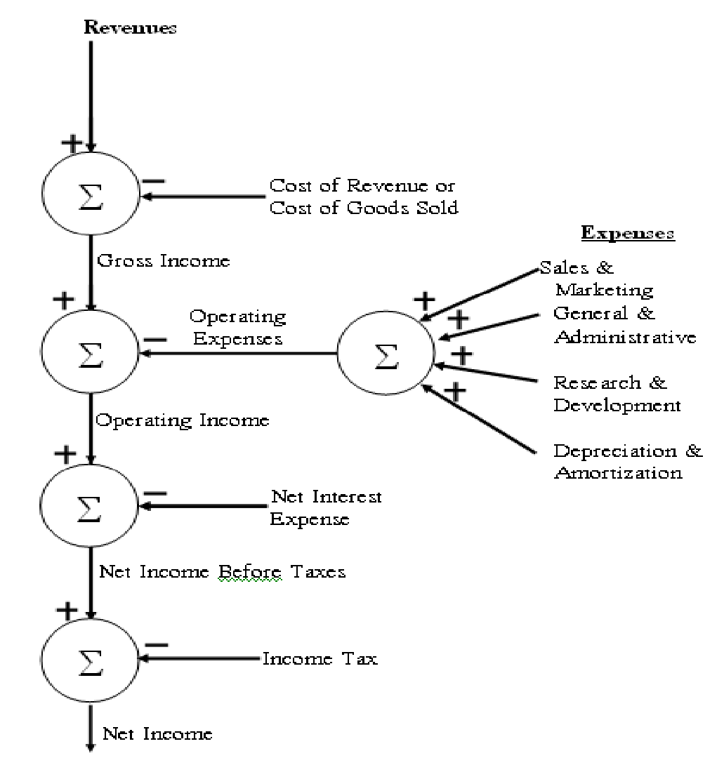
Financials - Income Statement
P&L
Balance sheet
Cash flow
Cap table
The deal
Revenue streams Cost structure Financing/Funding
Present summary of these
statements here.
Keep the detailed spreadsheets available for further discussions.
Keep the inputs made to
the financial model ready.

Slide 13
Financials Summary
#10
 | Year 1 | Year 2 | Year 3 | Year 4 | Year 5
Revenue
Cost of Goods Sold
Gross Profit
Operating Expenses
Operating Income
Interest
Net Income Before Taxes
Taxes
Net Income

Slide 14
Raising Money; Making and Selling #11
Year 1 & Year 2 Estimates of costs and revenues
Based on TAM, SAM, TM
Range of investments needed at each stage based
on development timeline
  For e.g. :
  INR 1-10 L – Bootstrap
  INR 10-100 L – Angel, Early VCs
  INR 100-1000 L – VCs
Who do you see as prospective investors?
  Approach these based on their philosophy and
funding size

Slide 15
Just Do It. NOW!

